Slide 1
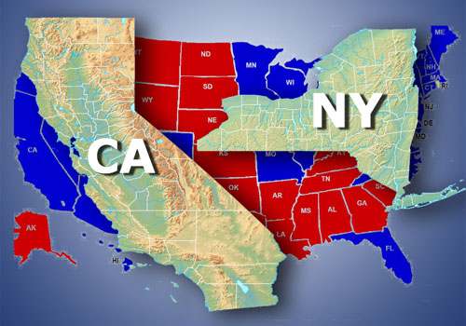
California vs. New York During the COVID-19 Pandemic
TEKM:
Tan Duong
Eric Kim
Karen Galindo Choudhary
Monte Rodriguez

Slide 2
Why COVID-19?
To put it simply, we want to delve deeper into this pandemic that has taking such a large impact on our daily lives.
On January 21st, 2020, the first case of COVID-19 was reported within the United States. The US quickly followed China, Korea, and Italy as an epicenter of the pandemic. Since January, the impact of COVID-19 changed all of our lives.
We are all afraid of contracting the virus and risking those around us;
We all are all directed to stay at home, unless we are essential workers or conducting essential activities;
When conducting essential activities, we are to practice “social distancing”, which means we maintain at least six feet between one another;
Unemployment is at a record high and non-essential workers now work from home;
Schooling of all levels are now conducted online;
Cities appear to be deserted when you look outside and air visibility is much better.

Slide 3
Which States We Chose to Study: California VS New York
California
Because our team resides in California;
Larger sample size; and
Coastal weather seemed ideal for analyzing air pollution
New York
Would be the most accurate reference (most cases and most testing done); and
Similarly to California, it is a large sample size, is a coastal state; however, it offers different conditions with regards to population size and weather type.

Slide 4
California vs. New York During the COVID-19 Pandemic
The Three Questions:
Which state followed the Stay-At-Home order better?
What if both states did not implement a Stay-At-Home or social distancing order?
Does the Stay-At-Home order affect air pollution in these two states? If so, is it a positive or negative effect?

Slide 5
Question #1: Which State Followed the Stay-At-Home Order Better?
Hypothesis:
If California has a lower growth in the daily average death rate after the Stay-At-Home order is placed, then California is following it better than New York
Notes:
E

Slide 6
Our Resources and Methodology:
GitHub COVID-19 Dataset:
From a reputable source (John Hopkins), which is updated daily, this dataset provided great detail. The data is separated by country, state, and date.
Fatality rate is more accurate than infection rate:
Fatalities are confirmed cases of COVID-19
Infection rate has more variables (lack of testing available, certain severity of symptoms patients needed to have, etc), therefore it is less accurate
14 Days : Current known incubation period for COVID-19 is 14 days. Therefore, 14 days after the initial Stay-At-Home order, the rate of death should begin to slow down.
Key Dates:
CA’s Stay-At-Home order was put into effect on March 19, 2020. The 14 day mark is April 2, 2020.
NY’s Stay-At-Home order was put into effect on March 22, 2020. The 14 day mark is April 5, 2020.
Our time frame ends on April 18, 2020.
Slope: Taken between two time periods after the stay-at-home order was implemented, the slope can provide insight on how death rate is affected by the stay-at-home orders for CA and NY.
Notes:
E

Slide 7
Stay-At-Home Guidelines:
To understand the impact COVID-19 had on CA and NY during the Stay-At-Home order, we needed to understand the details of this order. Below is what we found:
Both States:
Only essential businesses such as grocery stores, gas stations, pharmacies, and banks may remain open;
People may leave home to purchase food, medicine, exercise, and to care for relatives;
Always maintain a 6-foot distance from others when outside;
Gyms are closed;
If a restaurant remains open, they may only operate through delivery or take-out;
There is currently no curfew being enforced.
New York only: The fine for violating the social distancing policy in the amount of $1,000.00.
Notes:
K

Slide 8
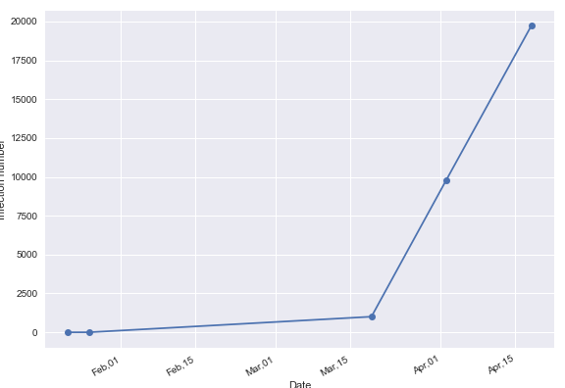
CA Infection Rate with the Stay-At-Home Order
Total infection from 1/22 - 4/18: 30,491 people
Total infection from 3/19 - 4/02: 9,768 people
Total infection from 4/02 - 4/18: 19,718 people
Total deaths from 3/19 - 4/02: 220 people
Total deaths from 4/02 - 4/18: 902 people
There are 1,122 deaths after the Stay At Home order began
Notes:
E

Slide 9
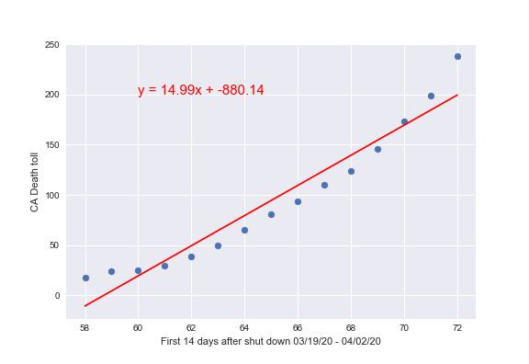
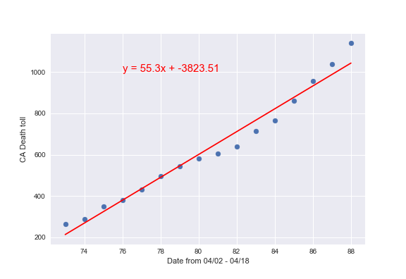
California Death Toll
The slope for 03/19 - 04/02 = 14.99
During this period the daily average death rate is 15 people
The slope for 04/02 - 04/18 = 55.30
During this period the daily average death rate is 55 people
There is a 269% growth of daily average deaths between these two periods in CA
Notes:
E

Slide 10
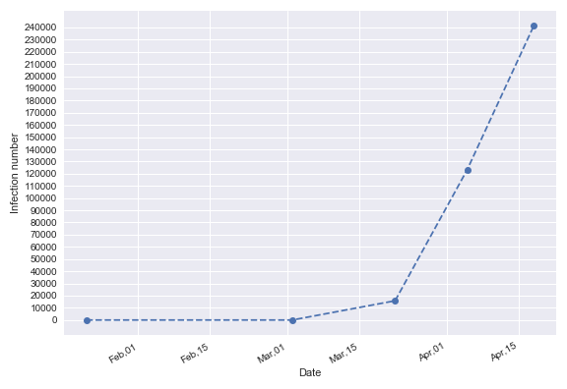
NY Infection Rate with Stay-At-Home Order
Total infection from 1/22 - 4/18: 241,712 people
Total infection from 3/22 - 4/05: 107,360
people
Total infection from 4/05 - 4/18: 118,552 people
Total deaths from 3/22 - 4/5: 3,912 people
Total deaths from 4/5 - 4/18: 13,642 people
There are 17,554 deaths after the Stay At Home order began
Notes:
K

Slide 11
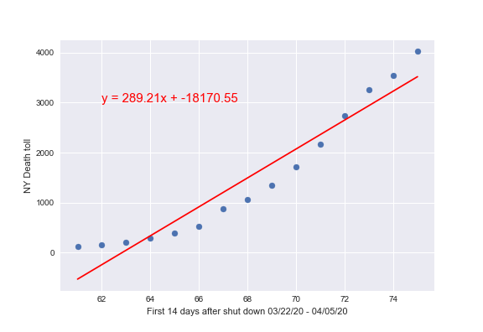
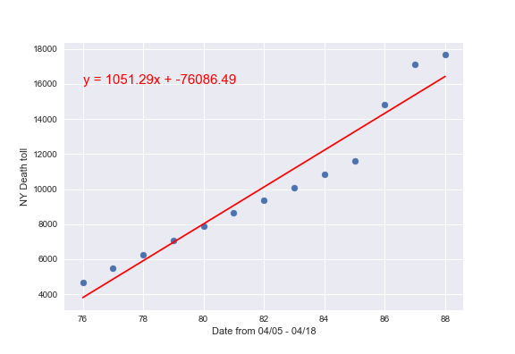
New York Death Toll
The slope for 03/22 - 04/05 = 289.21
During this period the daily average death rate is 289 people
The slope for 04/05 - 04/18 = 1,051.29
During this period the daily average death rate is 1,051 people
There is a 263% growth of daily average deaths between these two periods in NY
Notes:
K

Slide 12
Which State Followed the Stay-At-Home Order Better? The Answer...
Findings:
Based on our analysis, the growth of the daily average death rate is nearly the same when comparing California (269%) and New York (263%).
Conclusion: This question is too difficult to answer right now
The data could not identify which patients had pre-existing conditions
We could not take into account age of the population, which would vary greatly in both states.
The number of previous cases are continuously being updated because COVID-19 data is s fresh and the pandemic is ongoing.
Notes:
E and K

Slide 13
Reaction to COVID-19 Stay-At-Home and Social Distancing
In social media and news, we are seeing stories of how people are reacting to the Stay-At-Home order and social distancing
Some are using the opportunity to explore new hobbies
Some are protesting to cease the stay-at-home order
Some feel that only the sick should be quarantined
Studies show that 97.5% of patients in China developed symptoms in 11.5 days after exposure
This is why experts say we should follow Stay-At-Home orders and maintain social distancing
It is possible to carry the virus without knowing you have it
Notes:
K

Slide 14
Question #2 What if CA and NY Did Not Follow Social Distancing or the Stay-At-Home Order?
Hypothesis:
If CA and NY do not comply with the social distancing or the Stay-At-Home orders, then the number of infected cases should increase.
Notes:
E

Slide 15
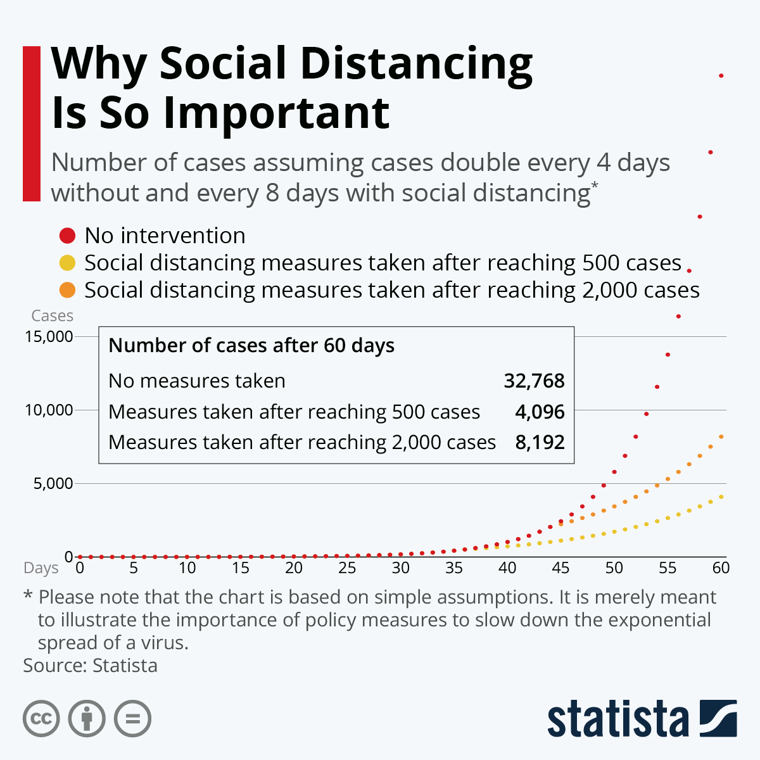
Our Resources and Methodology:
Statista- A general reference guide that interprets data into statistics
Dates- Utilized the dates when the Stay-At-Home orders were placed for each state to the end
CA Key Dates: 3/19 (order began), 4/18 (end)
NY Key Dates: 3/22 (order began), 4/18 (end)
Estimated Predictions- Calculated what the infection rate would look like without any form of social distancing
Bar graph- Used bar graphs to compare estimated predictions of infection rate to the actual data from the GitHub COVID-19 data set or CA and NY
Notes:
E

Slide 16
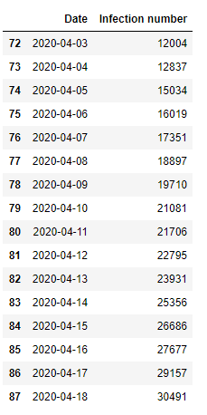
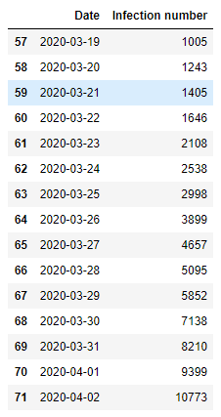
CA Without A Stay-At-Home Order or Social Distancing
03/19 - When the Stay-At-Home order was put into effect.
04/18- End of our time frame
Notes:
E

Slide 17
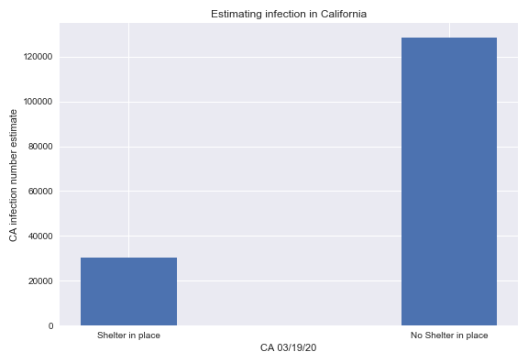
How the Stay-At-Home Order Affects CA Infection Rate
03/19 - There were 1,005 total number of infection cases
04/18 - There were 30,491 total infection cases
Without a Stay-At-Home order or social distancing measures in place, the number of infection cases would double every 4 days
04/18- The estimated number of infected cases reaches 128,640
Notes:
E

Slide 18
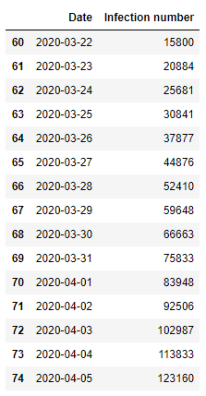
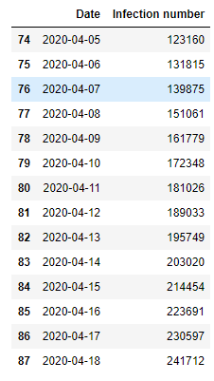
NY Without A Stay-At-Home Order or Social Distancing
3/22- When Stay-At-Home order began
4/18- End of our time frame
Notes:
K

Slide 19
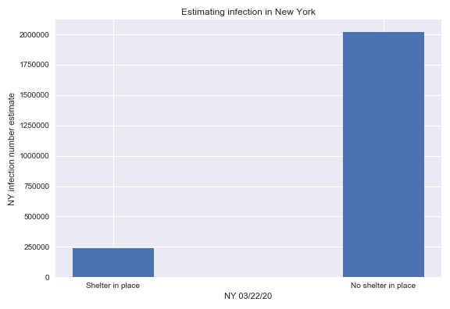
How the Stay-At-Home Order Affects NY Infection Rate
03/22- There were 15,800 total number of infection cases
04/18- There were 241, 712 total number of infection cases
Without a Stay-At-Home order or social distancing measures in place the number of infection cases will double every 4 days
04/18- The estimated number of infected cases reaches 2,022,400
Notes:
K

Slide 20
What if CA and NY Did Not Follow Social Distancing or the Stay-At-Home Order?
The Answer...
Our hypothesis is correct.
The number of infection cases will double every 4 days.
Although our estimated findings are hypothetical predictions, and the reality may not be as extreme, following social distancing and the Stay-At-Home orders slows the spread of COVID-19 which in turn lowers fatalities.
Complying with the Stay-At-Home order saves lives
Notes:
K

Slide 21
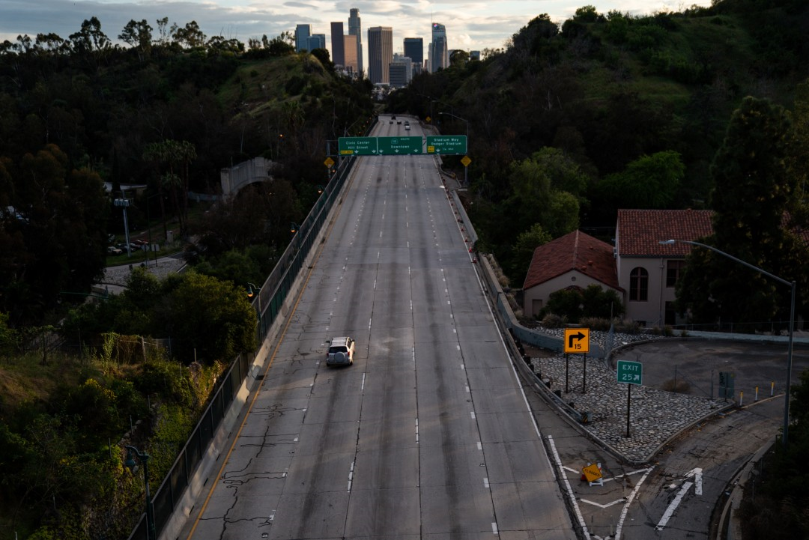
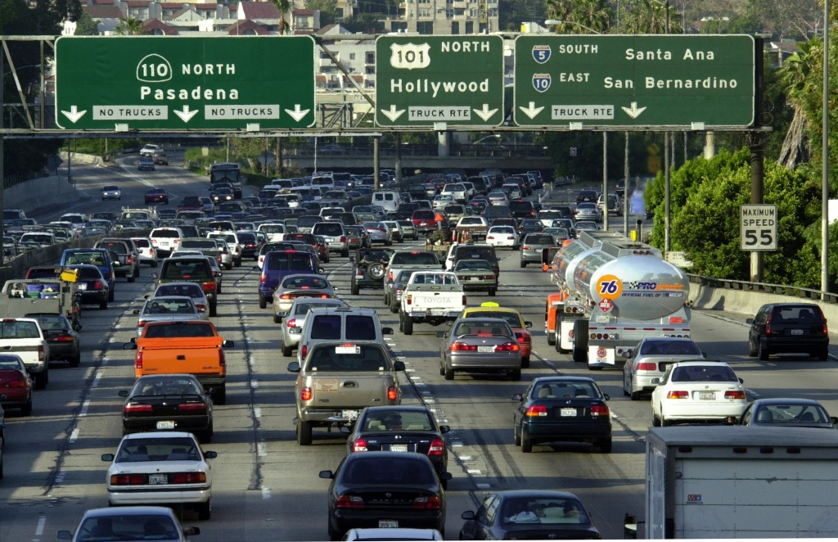
Rush hour on the CA 110 Freeway taken pre- pandemic (bottom) and on April 10, 2020 (right).

Slide 22


Times Square in New York City before and after lockdown order.

Slide 23
Question #3: Does the stay-at-home order affect air pollution in CA and NY? If so, is it a positive or negative effect?
Hypothesis:
Air pollution should improve dramatically due to people being indoors majority of the time.
Expecting to see an improvement in air quality from New York City as opposed to Los Angeles due to New York City having a denser population.

Slide 24
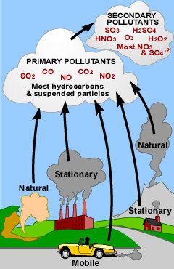
Air Pollution
Ozone: Good Ozone: Earth’s upper atmosphere, a protective layer that shields us from the sun’s harmful ultraviolet rays Bad Ozone: Earth’s lower atmosphere, formed when pollutants emitted by cars, power plants, chemical plants and other sources that chemically react with sunlight.
Particulate Matter (PM) 2.5: Small, 2.5 micrometer (“size of one human hair” particles. May come from construction sites, unpaved roads, fields, smokestacks or fires Health Risks: May have adverse effects to lunges and/or heart. Environmental Risks: Visibility Impairment Contribute to acid rain effects Can deplete the nutrients in soil

Slide 25
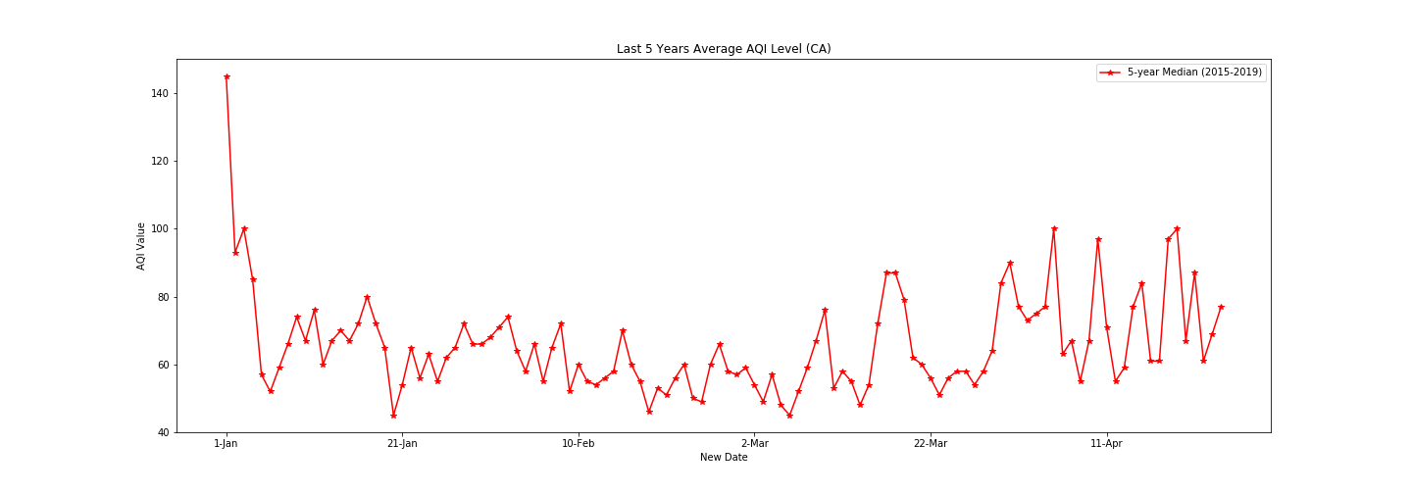
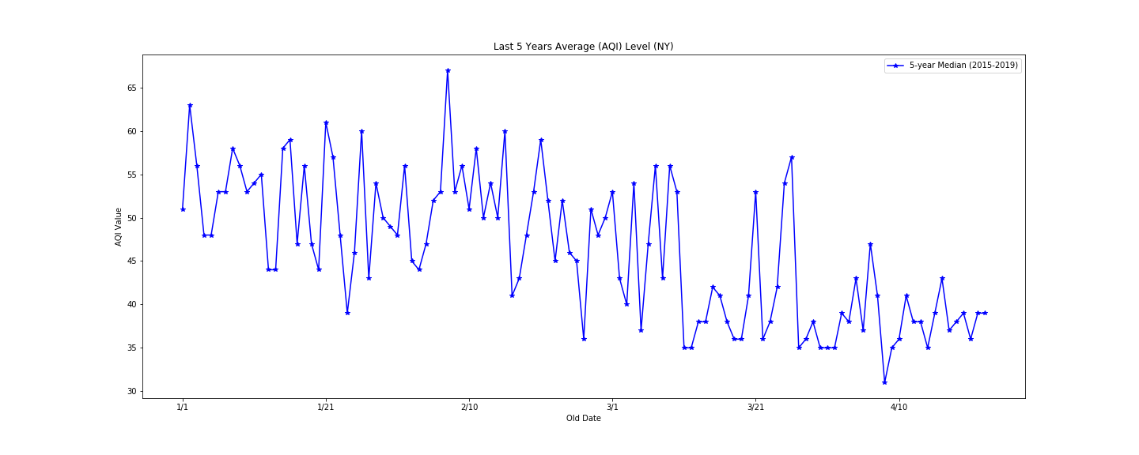
Last 5 Years Average (AQI) Level

Slide 26
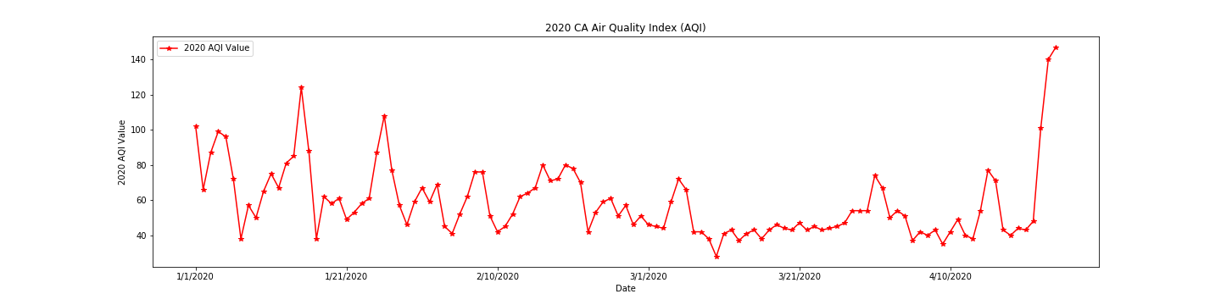
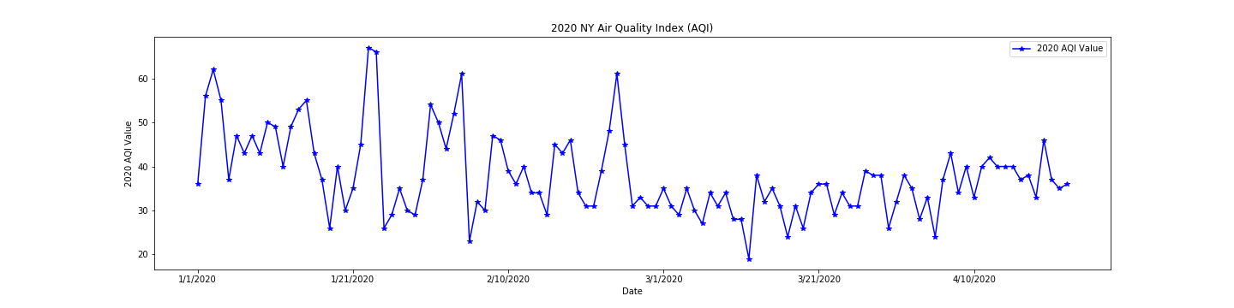
2020 AQI

Slide 27
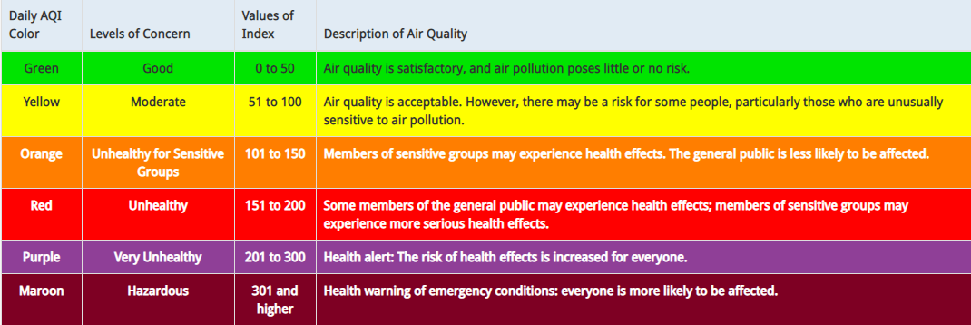
Air Quality Index (AQI) Descriptions

Slide 28

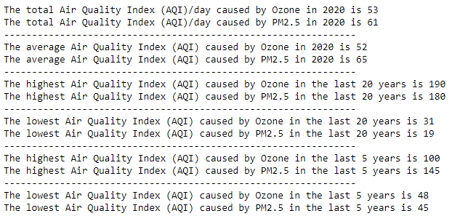
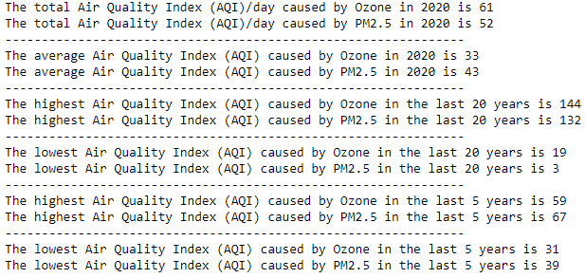
New York
California

Slide 29
CA vs. NY Air Pollution Overview and Conclusion
During our research, we were able to locate datasets that gave us insight into air quality index values (AQI) within the current year of 2020 and the last five years.
In California, the average air quality index level (AQI) was 59 (Moderate), with the highest being 147 (Unhealthy for Sensitive Groups) towards mid-April, and lowest being 28 (Good) mid-March.
In New York, the average air quality index level (AQI) was 38 (Good), with the highest being 67 (Moderate) towards the end of January and lowest being 19 (Good) mid-March.
Conclusion: During our set time frame, New York maintained a better AQI value than California. The main similarity identified was that both states hit their lowest AQI in mid-March.

Slide 30
Future Considerations
What are the contributing factors as to why NY has better AQI on average compared to CA when NY has a higher population density?
What is the reason for the dramatic spike in AQI in CA mid-April 2020?
Further analysis on outlier AQI values. Would require more time and research.
More direct comparison between cities of a similar population density and their use public transportation
New York VS London

Slide 31
Post-Mortem
Challenges and How we OVERCAME them:
TEKM’s Challenges:
Coming up with the right questions; Team meetings and consistent communication!
Finding accessible and consistent data; Collaborative research!
Eric’s Challenge:
Calculating regression line with dates on x-axis; reset index to a column and use as x-axis
Karen’s Challenge:
Writing the code efficiently so that it would work well with other code; collaboration
Tan’s Challenges:
Data is messy and not consistent, having to decide to either fix it in Excel or be a pro and use Pandas.
Smaller data set (Excel) . Larger data set (Pandas).
Not all data is available, even if you have a great idea, no data means you can not continue on with your project.
Use readily available data set to keep the project moving.
Monte’s Challenge: Unable to convert vital data into integer value; After being unable to resolve on my own, I was able to find the solution with the assistance from peers.

Slide 32


Slide 33
References
GitHub Covid-19 Data Set: https://www.cdc.gov/coronavirus/2019-ncov/symptoms-testing/symptoms.html
Washington Post Stay At Home Orders for Each State: https://www.washingtonpost.com/health/2020/04/06/coronavirus-stay-at-home-by-state/#newyork
Statista Benefits to Social Distancing and Staying Home: https://www.statista.com/chart/21146/why-social-distancing-measures-are-so-important/
CDC Symptoms https://www.cdc.gov/coronavirus/2019-ncov/symptoms-testing/symptoms.html
Novyden Facts About Coronavirus https://novyden.blogspot.com/2020/03/facts-about-coronavirus-disease-2019.html
Pollution (AQI): https://www.geo.sunysb.edu/bad-ozone/files/Download/lesson_plans_pacholik-2.htm https://www.epa.gov/outdoor-air-quality-data/air-data-daily-air-quality-tracker https://www.epa.gov/outdoor-air-quality-data/air-quality-index-daily-values-report

